Slide 1
Project Overview
Project :Diona fiscalisation
Company : Diona
Project manager : Igor Vukelić

Slide 2
Project Goals
Fiscalisation of all cash / credit / debit card payments
Every transaction need to have VAT amount and cashier unique identification country number
All transactions need to have fiscal confirmation number within 48h

Slide 3
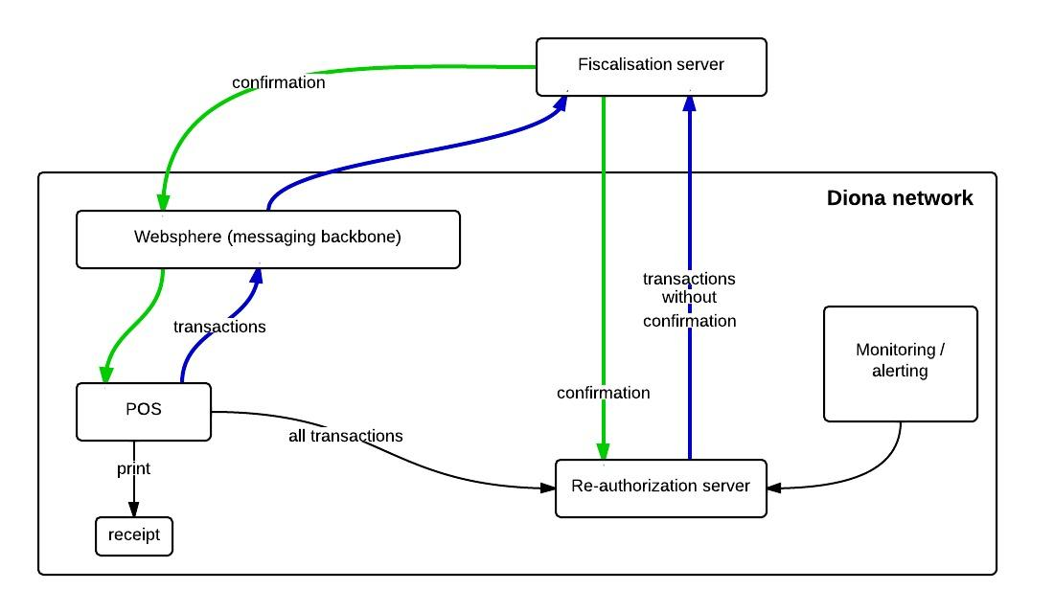
SCHEMA

Slide 4
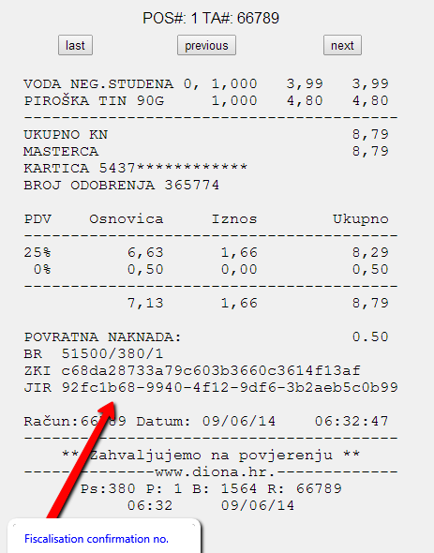
RECEIPT LAYOUT

Slide 5
KEY FACTORS
confirmation timeout
  our case 5s
perfomance/mapping testing on QA environment
  we did with similar number of transactions as on PRO system
monitoring / alerting
  get it done before go live

