Slide 1
Fiscalization in Croatia

Slide 2
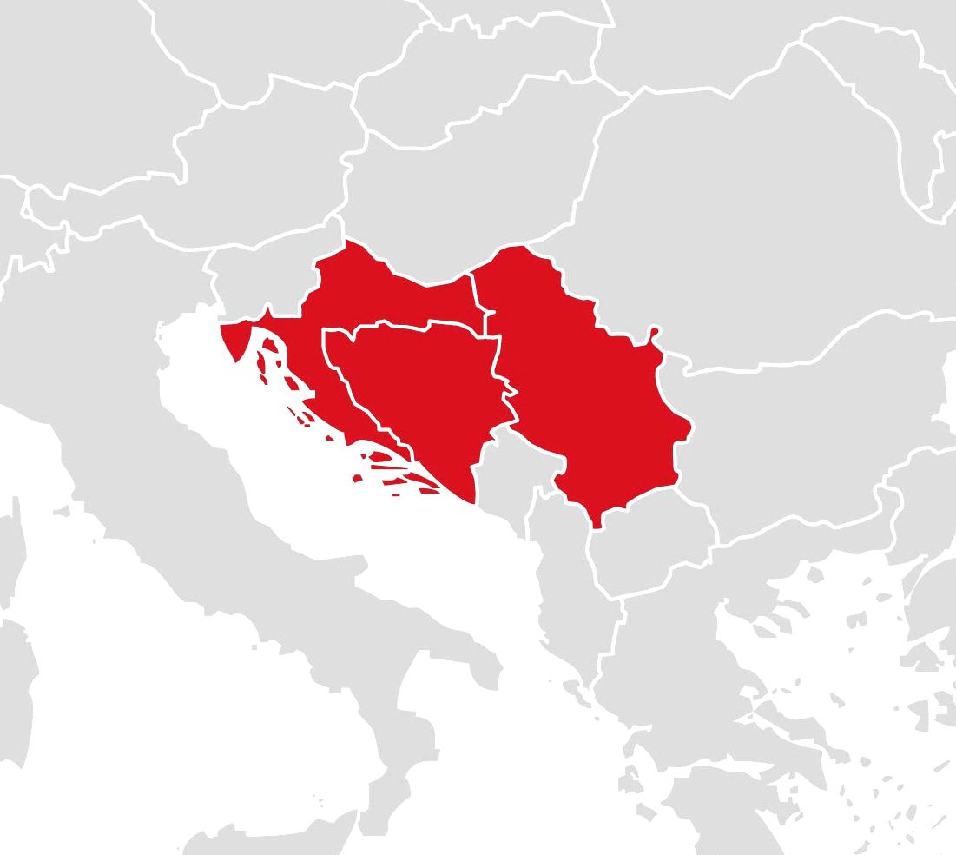

Strong regional footprint
Croatia
Population of 4.5 mn
Fairly consolidated market
#1 market position
Serbia
Population of 6.9 mn
Fragmented market
#3 market position
Bosnia and Herzegovina
Population of 4.6 mn
Fragmented market
#1 market position

Slide 3

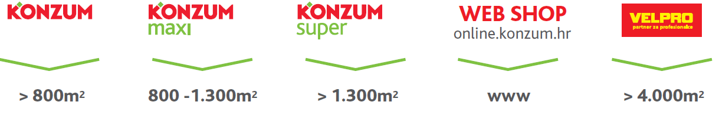
Multi-format retailer
More than 700.000 customers daily!

Slide 4
Before fiscalization
No government control on issuing receipts
Control on HQ level
Small businesses – trying to avoid VAT

Slide 5
Fiscalization
  Experience in Serbia and Bosnia
    Fiscal printers
    Item ID, VAT code and price sent to printer
    Using promotions – very difficult
    Synchronize POS and printer
  Decision:
    Avoid fiscal printers
    Use online fiscalization instead
    Every POS must have Internet connection

Slide 6
Fiscalization preparation
Rumors – April 2012
Discussion on technical solution – summer 2012
Model agreed – September 2012
Law – November 2012
Go-live – 1.1.2013

Slide 7
Implementation
PKI used for security
Security certificate issued by government agency (CA)
Law determined invoice and receipt numbering (receipt number/POS ID/Store ID)
POS creates security code – 32 digits hex number
Request sent as XML file with security code
APIS IT checks company ID from XML and security certificate
APIS IT creates unique ID (32 digits hex number – JIR) and sends it back to POS

Slide 8
Implementation
POS writes unique ID and prints receipt
Timeout not defined by law
Law allows to print receipt without unique ID (JIR)
All receipts without JIR must be sent to APIS IT within 48 hours
Possibility to check receipt online

Slide 9
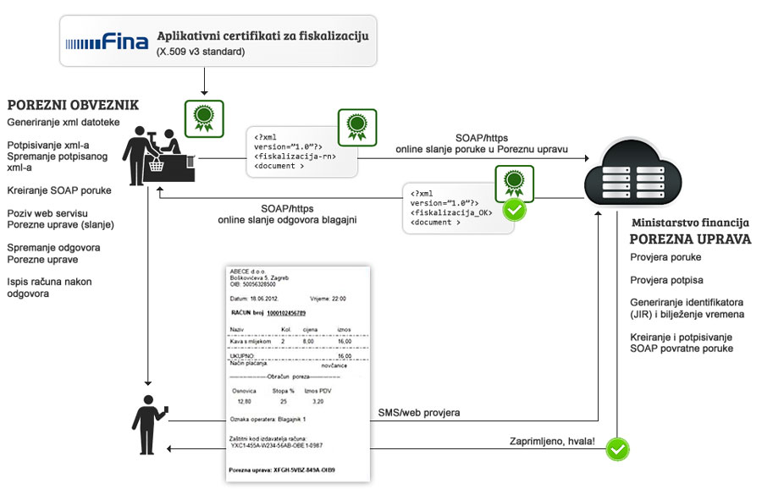
Implementation

Slide 10
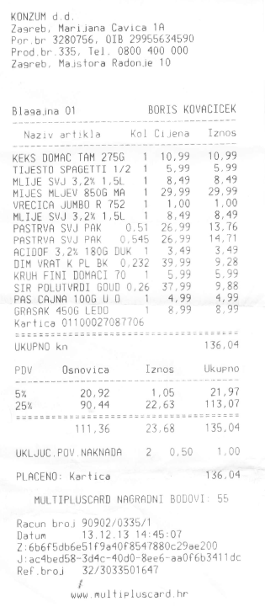
Implementation
Stores and working time is sent to APIS IT
Employee ID is sent on every receipt
Government is able to check:
      If we work according to working time
      Working time of each employee

Slide 11
Experience
98% fiscalized in first try
Average time – 700 ms
Control mechanism – check not fiscalized receipts

Slide 12
Thank you for your time

